Slide 1

Activity Recognition from Wearable Sensor
Presented by:-
Suyash Pandey(2342110052)
Tamnna (2342110053)
Tej Pratap (2342110054)
Under Guidance of
Mr. Jayati Krishna Goswami

Slide 2
Contents
Introduction
Literature Review
Proposed method
Results and Discussion
Conclusion
References

Slide 3
Introduction
Recognizing and monitoring human activities are fundamental functions to provide healthcare and assistance services to elderly people living alone, physically or mentally disabled people, and children. [1]
With the growth of IoT and wearable devices, deep learning models—particularly ones that combine convolutional feature extraction with attention mechanisms—are now being used to learn discriminative patterns from sensor data for human activity recognition (HAR). [2]
Human Activity Recognition (HAR) remains an active and evolving research field, with attention-based architectures offering improved interpretability and robustness for real-world wearable sensor data. [3]

Slide 4
Literature Review
Prior research includes k-NN, SVM, and HMM. Studies show k-Nearest Neighbor (k-NN) and SVM offer simplicity but limited feature extraction capabilities, while Hidden Markov Model (HMM) captures temporal dependencies but requires strong assumptions.[4]
Deep learning models such as Convolutional Neural Networks (CNNs) and Attention-based architectures significantly improve classification accuracy and automate feature extraction and handle complex patterns. [5]
Existing deep learning approaches show promise but require further optimization. [6]
Key challenges include ensuring user privacy, handling variability in sensor signals, and maintaining transparency. Explainable AI and attention visualization methods are increasingly used to enhance model understanding and trust [7]

Slide 5
Proposed Method
The proposed method employs a hybrid CNN–LSTM deep learning model for accurate human activity recognition using wearable sensor data.
Raw data from accelerometers and gyroscopes are preprocessed by handling missing values, encoding categorical activity labels, and retaining only numeric sensor features.
The dataset is divided into training, validation, and test sets to ensure balanced evaluation. Feature scaling is performed using StandardScaler to normalize sensor signals for stable model training.

Slide 6
Proposed Method Conti..
Sensor data is segmented into fixed-length time windows and reshaped into 3D tensors (samples, time steps, features) as input to the CNN.
The 1D convolutional layers extract local spatial features, and the LSTM layers learn temporal dependencies across these windows.
The final fully connected layers classify activities using softmax activation. Model training is optimized with the Adam optimizer and early stopping based on validation accuracy to prevent overfitting.

Slide 7
Proposed Method Conti..
The CNN–LSTM model effectively captures both spatial and temporal dependencies from wearable sensor data.
This hybrid structure enables better discrimination between similar human activities compared to standalone CNN or LSTM models.
The integration of preprocessing techniques such as feature scaling and stratified train-test splitting ensures robustness and model generalization across diverse activity classes.

Slide 8
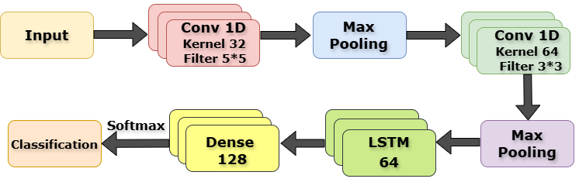
Proposed Method
Fig 1 : Proposed Model Flowchart

Slide 9
Results and Discussion
The proposed CNN–LSTM model achieved an overall test accuracy of about 98%, confirming its strong capability for recognizing multiple human activities from wearable sensor data.
Evaluation metrics show high performance across all classes — precision (94–98%), recall (95–97%), and F1-score (95–99%), demonstrating balanced and reliable classification. You can see in fig 2
The combination of convolutional and LSTM layers in fig 1 enables the model to automatically extract spatial–temporal patterns from sensor sequences, improving recognition accuracy even for activities with subtle motion differences.
The confusion matrix indicates consistently high true-positive rates across most activity classes, showing robust performance and minimal confusion between similar movements.

Slide 10
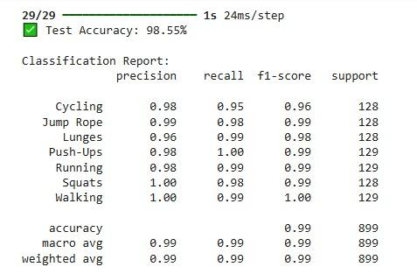
Results and Discussion
Fig 2 : Evolution Matrix

Slide 11
Results and Discussion
The CNN–LSTM architecture generalizes well to unseen users due to subject-based data splitting, which ensures the model learns activity patterns independent of individual motion styles.
Compared with traditional machine-learning approaches (e.g., k-NN, Decision Tree, Random Forest), this deep learning model provides significantly higher accuracy and better handling of temporal dependencies.
Training with early stopping helped prevent overfitting, while feature scaling stabilized model convergence. Although our model is overfit but no too much as compared too other model.
The trained model maintains low latency during inference, making it practical for real-time fitness or healthcare monitoring using wearable devices.

Slide 12
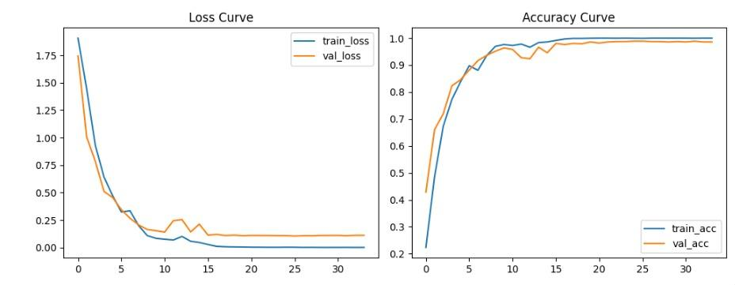
Results and Discussion
Fig 3 : Evolution Matrix

Slide 13
Conclusion
The hybrid CNN–LSTM model effectively recognizes human activities using wearable sensor data by capturing both spatial and temporal dynamics.
The model achieved high and balanced performance (≈98% accuracy, 95–99% F1-score) across activity classes, proving its reliability for real-world applications.
Preprocessing methods such as feature scaling and subject-based validation improved robustness and ensured consistent results across diverse subjects.
The model’s lightweight design allows deployment on edge or wearable devices for continuous, real-time monitoring.
Future work may focus on multi-sensor fusion, real-time edge optimization, and explainable AI visualization for better interpretability.

Slide 14
References
[1] Attal, F., Mohammed, S., Dedabrishvili, M., Chamroukhi, F., Oukhellou, L., & Amirat, Y. (2015). Physical Human Activity Recognition Using Wearable Sensors. Sensors, 15(12), 31314–31338
[2] Akter M., Ansary S., Khan M.A.-M., Kim D. Human Activity Recognition Using Attention-Mechanism-Based Deep Learning Feature Combination. Sensors 2023
[3] Wang Y., Cang S., Yu H., et al. Attention mechanism & wearable sensor-based HAR: TCN-Attention-HAR: human activity recognition based on attention mechanism time convolutional network. 2024.
[4] Khan et al., "Physical Human Activity Recognition Using Wearable Inertial Sensors," Sensors, 2015
[5] Alarfaj et al., "Wearable Sensors Based on AI Models for Human Activity Recognition," Frontiers in AI, 2024

Slide 15
References
[5] Akter M. et al., Human Activity Recognition Using Attention-Mechanism-Based Deep Learning Feature Combination, Sensors 2023
[6] Wang Y. et al., TCN-Attention-HAR: Human Activity Recognition Based on Attention Mechanism Time Convolutional Network, Expert Systems with Applications, 2024.
[7]Serpush F. et al., Wearable Sensor-Based Human Activity Recognition in the Healthcare Sector: A Survey, IEEE Sensors Journal, 2022.

Slide 16
Thankyou

